Slide 1
Special Educational Needs Information Report
How we support children and young people with special education needs and disabilities
‘No Child Left Behind’
'SEND is everyone's responsibility'

Slide 2
Welcome to our Arrow Vale SEND Information report. This can be looked through page by page and later in the document – please use the ‘quick links’, to find answers to specific questions.

Slide 3
SEND Information Report: Key Contacts
We welcome any feedback and any suggestions for involvement in this offer, so please do contact us and make an appointment.
If you think your child may have a learning barrier, special educational need or disability, please call us on 01527 526800, or email us at avasenco@arrowvaleacademy.co.uk and we will triage appropriately
Laura Davis – Director of SEND
Hannah Alabaster – Assistant SENDCo
Debbie Smith – SLT SEND Link
Gary Tomlinson – SEND Governor
Claire Round – CRST SEND Lead

Slide 4
SEND Information Report: SENDIASS
If you need any independent help or support, please contact SENDIASS: Special Educational Needs and Disabilities Information and Support Services
SENDIASS Worcestershire and Herefordshire (hwsendiass.co.uk)
Return to ‘quick links’

Slide 5
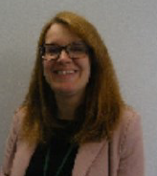
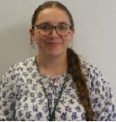
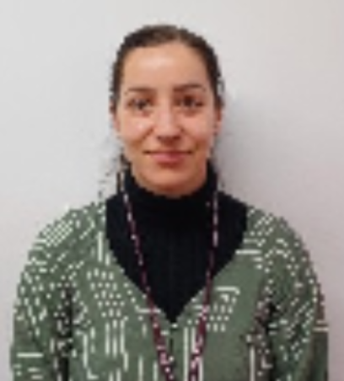
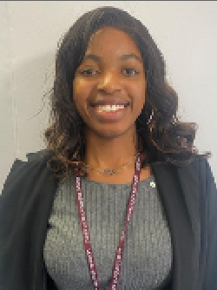
SEND Information Report: Meet the Team
Laura Davis Director of SEND and Inclusion and Deputy Designated Safeguarding Lead | Hannah Alabaster Assistant SENDCO | Naomi Beckford Higher Level Teaching Assistant | Jana Harvey Higher Level Teaching Assistant | Jo Banner Achievement Assistant | Rachael Sazio Achievement Assistant
Angela Timothy Achievement Assistant | Ashley Lune Achievement Assistant | Jez Thomas Achievement Assistant | Michaela Simmonds Achievement Assistant | Tashantie Thomas Achievement Assistant | Michelle Hamer Achievement Assistant

Slide 6
We work alongside the Worcestershire County Council Local Offer: SEND Local Offer | Worcestershire County Council. A video guide can also be found here: https://youtu.be/LyEo2FySJiQ
SEND Information Report: Local Offer
Return to ‘quick links’

Slide 7
SEND Information Report: Local Offer
We work alongside the Worcestershire County Council Local Offer and use The Graduated Response to help support students.
This means we assess where barriers are, plan support and ensure this is reviewed at a timely point.
If you feel the current plan is not working, please contact the SEND Team; key worker or form tutor in the first instance.

Slide 8
SEND Information Report: The Graduated Response
When a student needs more specialist help there is a Directory of Agencies used by the school, that is referred to for Wave 3 specialist intervention. e.g.:
SEND Supported (Autism, Social, Emotional and Mental Health and Cognition & Learning);
Chadsgrove (Physical Disability, Dyslexia)
CAMHs, WEST, In school wellbeing referrals, Pet Assisted Therapy, Boxing, Mentoring (Mental Health)
SENDIASS (Post 16 Advice and Guidance)
Umbrella Pathway (assessment for ASD)
SALT (Communication and Interaction/Speech & Language)
Community Paediatrics (assessment for ADHD)
Educational Psychology
Some of these services have very long waiting lists nationally – we will suggest adaptations before a diagnosis is given.
When a student continues to make less than expected progress, despite support and interventions that are matched to their area of need, we will consider involving specialists or external agencies Wave 2 Targeted / Wave 3 bespoke interventions.
Whenever we think specialists should be involved, we seek parent/carer permission first.
Following a meeting or assessment with a specialist we will share what was discussed and/or agreed with the parent/carer and teachers of the student, through an individualised learning plan.
Wave 3:
Specialist and personal interventions usually from a professional which could be external
Wave 2: Additional intervention; targeted and based on students’ needs
Wave 1: Quality First Teaching
Inclusive and adaptive teaching
Ordinarily Available Provision
Every teacher is required to adapt the curriculum to ensure access to learning for all children in their class.
High quality personalised teaching, adjusted for student’s needs, is the first way we respond to students who have SEND or any learning barrier
Additional intervention and support cannot make up for a lack of good/outstanding teaching. To support this, teaching at Arrow Vale is regularly reviewed. We have a thorough teacher and support staff CPD training programme to ensure teachers’ understanding of strategies to support and identify vulnerable students and their knowledge of SEND is up to date.
When a student is identified as having SEND, we use the four-step Graduated Approach process to ensure barriers to learning are removed and effective provision is put in place.
The Assess, Plan, Do, Review Cycle ensures that students’ and parents’/carers’ needs are at the centre of all provision provided by a “Team around the Child” approach

Slide 9
SEND Information Report: Outside Agency Testimonials
Leigh Brecknell: SEN Profiler, HOW College | Leonie Berry: Managing Director, SEND Supported | Mark Loveday: former Head of School Support Services, Chadsgrove
“In our experience, the relationship we have with Arrow Vale and the SEN department has been an extremely positive collaboration which has benefited the students greatly, allowing them to succeed and progress in all walks of life” | "SEND Supported works in partnership with Arrow Vale to promote improved outcomes for learners with Special Educational Needs and Disabilities (SEND). Arrow Vale works collaboratively with SEND Supported to raise school capacity to meet the additional needs of their students. Consultants have extensive experience in their fields, offering advice, guidance and training in autism, communication & interaction, dyslexia, specific language disorder, cognition & learning and social emotional and mental health (SEMH). Arrow Vale is committed to promoting inclusive opportunities for their learners through creative solutions and providing personalised student provision. We very much value our productive working relationship with Arrow Vale” | “Staff liaise well with the PD Outreach Team to ensure the needs of pupils with physical disabilities are met.”

Slide 10
SEND Information Report: Safeguarding
Safeguarding Pupils with SEND
As part of the Arrow Vale High School’s dedication to safeguarding all children, we acknowledge that some pupils who have additional needs may be more vulnerable than their peers to abuse.
As a result, all staff receive annual safeguarding training, with particular attention to the latest version of Keeping Children Safe in Education.
“Children with special educational needs or disabilities (SEND) or certain medical or physical health conditions can face additional safeguarding challenges both online and offline.”
The Director of SEND is also a Deputy Designated Safeguarding Lead and can advise on how to effectively safeguard students with SEND.

Slide 11
SEND Information Report: Staff Testimonials
Claire Round: CRST Director of SEND | Laura Davis: Director of SEND and Inclusion | Sam Lune: CRST EHCP Lead | Hannah Alabaster: Assistant SENDCO
At Arrow Vale and within our CRST Trust I believe that every pupil deserves the right to experience and access a personalised, adjusted and inclusive education every single day, that will inspire further/higher education, an apprenticeship or employment in preparation for adulthood. 'Nothing is impossible' and there should be 'No Child Left Behind’ | The Arrow Vale community is truly inclusive. As a new member of staff making this important transition, I have been welcomed with compassion and joy. This message is warmly received by students. I cannot wait to get to know the whole community and contribute to the incredible ethos and culture of the Learning Support Team and the wider school. | The feedback I receive from parents, carers, and professionals most often is that they can see how passionate we are about what we do in SEND at Arrow Vale. They are completely right. Every single member of staff wants the very best for every young person and we believe in doing ‘whatever it takes’ to achieve that for them. I am proud to work at CRST and to support this community. | I feel privileged to be part of a team that is so child-centred. I am proud to work alongside others who care and work tirelessly to support our students both academically and emotionally.

Slide 12
SEND Information Report: Student Testimonials
“The reader in my exam helps me as I understand things better if it is read to me”
“It is a wonderful calm place where I have friends that help me and support me in the best and worst of times, I may have … and still face”.
“I feel the school offers a good amount of help and support to students”.
“My Keyworker always helps me with my problems or concerns I have at school and home. Best school I have ever been to!”
“I love being in Learning Support because it makes me feel safe and knowing that I can come here for help. Thank you.”

Slide 13
SEND Information Report: Family Testimonials
“He seems happier and appears to be working hard in school at present, so the Learning Support Team have done a good job!”
“I have found the Learning Support department at Arrow Vale very supportive with my lad and they have tailor made his package around his needs and have also taken on board any suggestions that may help that we currently use at home. We are currently going through the Umbrella assessment and professionals have been used in the school to make this process easier so it’s important that consistency is followed with school and home life. This has been crucial and the communication between the two environments has really helped.”
“My concerns were taken seriously, and I felt supported at all times”.

Slide 14
SEND Information Report: SEND Needs Analysis over time
YEAR | 2017/18 | 2018/19 | 2019/20 | 2020/21 | 2021/22 | 2022/23 | 2023/24 | 2024/25
EHCP | 11 | 14 | 10 | 11 | 11 | 12 | 14 | 28
SEN 'K' | 106 | 95 | 95 | 103 | 98 | 107 | 104 | 103
MALE | 78 | 75 | 76 | 78 | 63 | 75 | 72 | 73
FEMALE | 39 | 34 | 29 | 36 | 35 | 44 | 46 | 54

Slide 15
What are the 4 broad categories of SEND need in the Code of Practice 2015? See separate ‘Areas of Need’ document for more details

Slide 16
Page 1 Quick links:
What should I do if I think my child has Special Educational needs?
How does the school know if a child needs extra help?
How will both school and I know how my child is doing?
How will school help me support my child’s learning?
How will the curriculum be matched to my child’s needs?
How are the school’s resources allocated and matched to children’s SEND?
How will the school decide the type of support my child will receive P1
How will the school decide the type of support my child will receive P2
How does the school judge whether the support has had an impact?
How will my child be included in activities outside the classroom including school trips? P1
How will my child be included in activities outside the classroom including school trips? P2
What support will there be for my child’s overall well-being?

Slide 17
Page 2 Quick links.
What training have the staff supporting SEND had or what are they having?
How accessible is the school both indoors and outdoors?
How are parents involved in the school? How can I get involved?
How do children contribute their views about their support and who can help them P1
How do children contribute their views about their support and who can help them P2
What specialist services are available or can be accessed by the school?
How will the school prepare and support my child when transferring classes or schools P1
How will the school prepare and support my child when transferring classes or schools P2
Who can I contact for further information or to complain about SEND issues?
The Local Offer
School Contact details:
SENDIASS - What other support services can help me?

Slide 18
What should I do if I think my child has Special Educational needs?
The Code of Practice (2015) defines SEND as:
A child or young person has SEN if they have a learning difficulty or disability, which calls for special educational provision to be made for them.
A child of compulsory school age or a young person has a learning difficulty or disability if they:
(a) Have a significantly greater difficulty in learning than the majority of others of the same age; or
(b) Have a disability, which prevents or hinders them from making use of educational facilities of a kind generally provided for others of the same age in mainstream schools or mainstream post-16 institutions.
At Arrow Vale if a learner is identified as having SEND, provision that is ‘additional to or different from’ the normal personalised, adjusted and inclusive curriculum, we will begin to overcome the barrier to their learning through a Graduated Response Approach.
Please contact us: 01527 526800
avasenco@arrowvaleacademy.co.uk
Return to ‘quick links’

Slide 19
How does the school know if a child needs extra help?
When a student continues to make less than expected progress, despite support and interventions that are matched to their area of need, we will consider involving specialists or external agencies Wave 2 Targeted / Wave 3 bespoke interventions.
Whenever we think specialists should be involved, we seek parent/carer permission first. Following a meeting or assessment with a specialist we will share what was discussed and/or agreed with the parent/carer and teachers of the student, through an individualised SLIP or passport.
When a student needs more specialist help there is a Directory of Agencies used by the school, that is referred to for Wave 3 specialist intervention. These may include:
SEND Supported (Autism, Social, Emotional and Mental Health and Cognition & Learning);
Chadsgrove (Physical Disability, Dyslexia)
CAMHs, WEST, In school wellbeing referrals, Pet Assisted Therapy, Boxing, Mentoring (Mental Health)
SENDIASS (Post 16 Advice and Guidance)
Umbrella Pathway (assessment for ASD)
SALT (Communication and Interaction/Speech & Language)
Community Paediatrics (assessment for ADHD)
Educational Psychology
Return to ‘quick links’

Slide 20
How will both school and I know how my child is doing?
Monitoring takes place in many forms and all subject teachers are responsible for the progress of any student with SEND. This monitoring can take place in many forms:
Lesson Observations
Observations of students – their work / book scrutiny / learning walks
Marking and feedback: Key assessment data sent out throughout the year
Link Meetings by SLT with DLS/HOY/YTL
Student and parent/carer / staff evening meetings – reports as required – with positive and structured conversations.
Key Worker monitoring and communication
Meetings available as and when needed
Return to ‘quick links’

Slide 21
How will school help me support my child’s learning?
Edulink: an online App, for parents, staff and students - which will aid communication with home and where all homework is set.
Meeting requests: Student Support including the Learning Support Team are available upon request. Parents are encouraged to share all relevant information as they know students best. These discussions will help us identify the responsibility the parent/carer, student and the school have towards the best statutory outcomes for the student.
Arrow Vale School Website: Curriculum maps and information of parental support groups, mental health and well-being support, signposting to relevant agencies
Team Around the Child meetings in school: leading to an individual provision SLIP that outlines strategies for teaching staff
Attendance support: directing to SEND professionals to support school attendance
Community Café: for all families with children and young people with SEND. Families are given the chance to be fully involved with discussions and ideas for improvement
Learning Support Team: will be in contact regularly if to talk about their young persons' needs and the activities and support they will receive to help them make progress if they have SEND/EHCP
Children with SEND who are also Looked After will have meetings in school in relation to their PEP (Personal Education Plan) every term. This is led by the Heads of Year and the Virtual School
Return to ‘quick links’

Slide 22
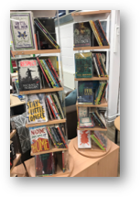
How will the curriculum be matched to my child’s needs?
At Arrow Vale we endeavour to ensure each student with SEND gets the quality teaching and support they need. Subject teachers are responsible for the progress and development of students in their class, including the support given by Achievement Assistants or external agencies. Each subject has a curriculum map, available on our website.
Every teacher is required to adapt the curriculum to ensure access to learning for all children in their class. The National Teacher Standards detail the expectations on all teachers. High quality personalised teaching using the Ordinarily Available provision, adjusted for student’s needs, is the first way we respond to students who have SEND or any learning barrier
Additional intervention and support cannot make up for a lack of good/outstanding teaching. To support this, teaching at Arrow Vale is regularly reviewed. We have a thorough teacher and support staff CPD training programme to ensure teachers’ understanding of strategies to support and identify vulnerable students and their knowledge of SEND is up to date. When a student is identified as having SEND, we use the four-step Graduated Approach process to ensure barriers to learning are removed and effective provision is put in place.
The Assess, Plan, Do, Review Cycle ensures that students’ and parents’/carers’ needs are at the centre of all provision provided by a “Team around the Child” approach
Return to ‘quick links’

Slide 23
How are the school's resources allocated and matched to children’s special educational needs?
Arrow Vale receives a ‘notional budget’ funding directly to the school from the local authority to support the needs of all learners with SEND. This is a set amount which does not increase or decrease with the amount of students on the SEND Register. This is not personally allocated to your child.
All Departments have a budget to provided resources appropriate to need
Pupils with an EHCP may have Higher Level needs funding attached to their provision, evidenced through individual costed provision maps.
Return to ‘quick links’

Slide 24
How will the school decide the type of support my child will receive? (Page 1)
The PASS (Pupil Attitudes to Self and School) Survey – identifying attitudes to school and emotional well-being may lead to wellbeing support alongside staff referrals
Class teachers, form tutors, support staff, parents/carers and the learner themselves will be the first to notice a difficulty with learning. At Arrow Vale we ensure that assessments directly involves the learner, their parents/carer and of course their teacher. The Learning Support Team will also implement personalised support following the identification of specific barriers to learning.
We use diagnostic tests in tandem to create a plan for students: these include the Dyslexia Screener in Year 9; termly NGRT reading tests for Years 9-11; WRAT6 Spelling test in Year 9 and DASH Handwriting and free writing test in Year 9. More testing may take place if there is an issue highlighted.
We have a range of assessment tools available alongside the advice and input of numerous external agencies and services for alternative and appropriate 'Progress' pathway curriculum delivery, exam access arrangement support and provision off-site if needed
For some learners we may want to seek advice from specialist teams listed in Wave 3 provision
Return to ‘quick links’

Slide 25
How will the school decide the type of support my child will receive? (Page 2)
Through regular key assessment data collections and monitoring we can identify students who are making less than expected progress for their age and individual circumstances.
If a learner is identified as having SEND, provision that is ‘additional to or different from’ the ordinarily available provision, will begin to overcome the barrier to support to their learning through a Graduated Response Approach.7
Learners can fall behind in school for lots of reasons. This may be because their progress is a result of:
Gaps in their learning following a prolonged absence from school
Developmental delay
Gaps in speech and language understanding
Past trauma or life events
Return to ‘quick links’

Slide 26
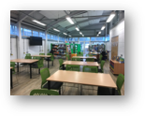
How does the school judge whether the support has had an impact?
At Arrow Vale we have rigorous assessment procedures to ensure we are keeping track of student progress throughout their time with us.
Two to four times a year parents will receive a key assessment report on their child’s progress which is thoroughly analysed by SLT and the wider team.
At least once a year, parents of students with an EHCP will be invited into school to attend their annual review.
Key Workers monitor key SEND students .
Progress data of all learners is collated by the whole school and monitored by DLS / Senior Leadership Team and termly meetings with Governors
Return to ‘quick links’

Slide 27
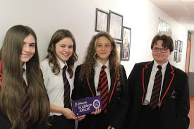
How will my child be included in activities outside the classroom including school trips? (Page 1)
At Arrow Vale we work hard to ensure that students with SEND engage in all the activities of the school alongside students who do not have SEND. We will try to make sure that students with any additional needs are able to take part fully in school visits and events. We pride ourselves on being an inclusive school, and that there is 'No Child Left Behind'.
In addition to the school curriculum, many subject areas run educational visits to enrich the experiences our students have, locally, regionally, nationally and internationally. The school also runs enrichment programs and activities during lunchtimes and after school where all students have the opportunity to broaden their experiences outside the curriculum.
No student will be excluded from extra-curricular activities on the basis of SEND. We have a full inter-house system and SEND students compete alongside their peers as far as possible. Our students take part in numerous inter-school/inter-area games – e.g., football tournaments & Boccia.
Students also get involved in Community Care, with Christmas Hampers just one example of outreach
Return to ‘quick links’

Slide 28
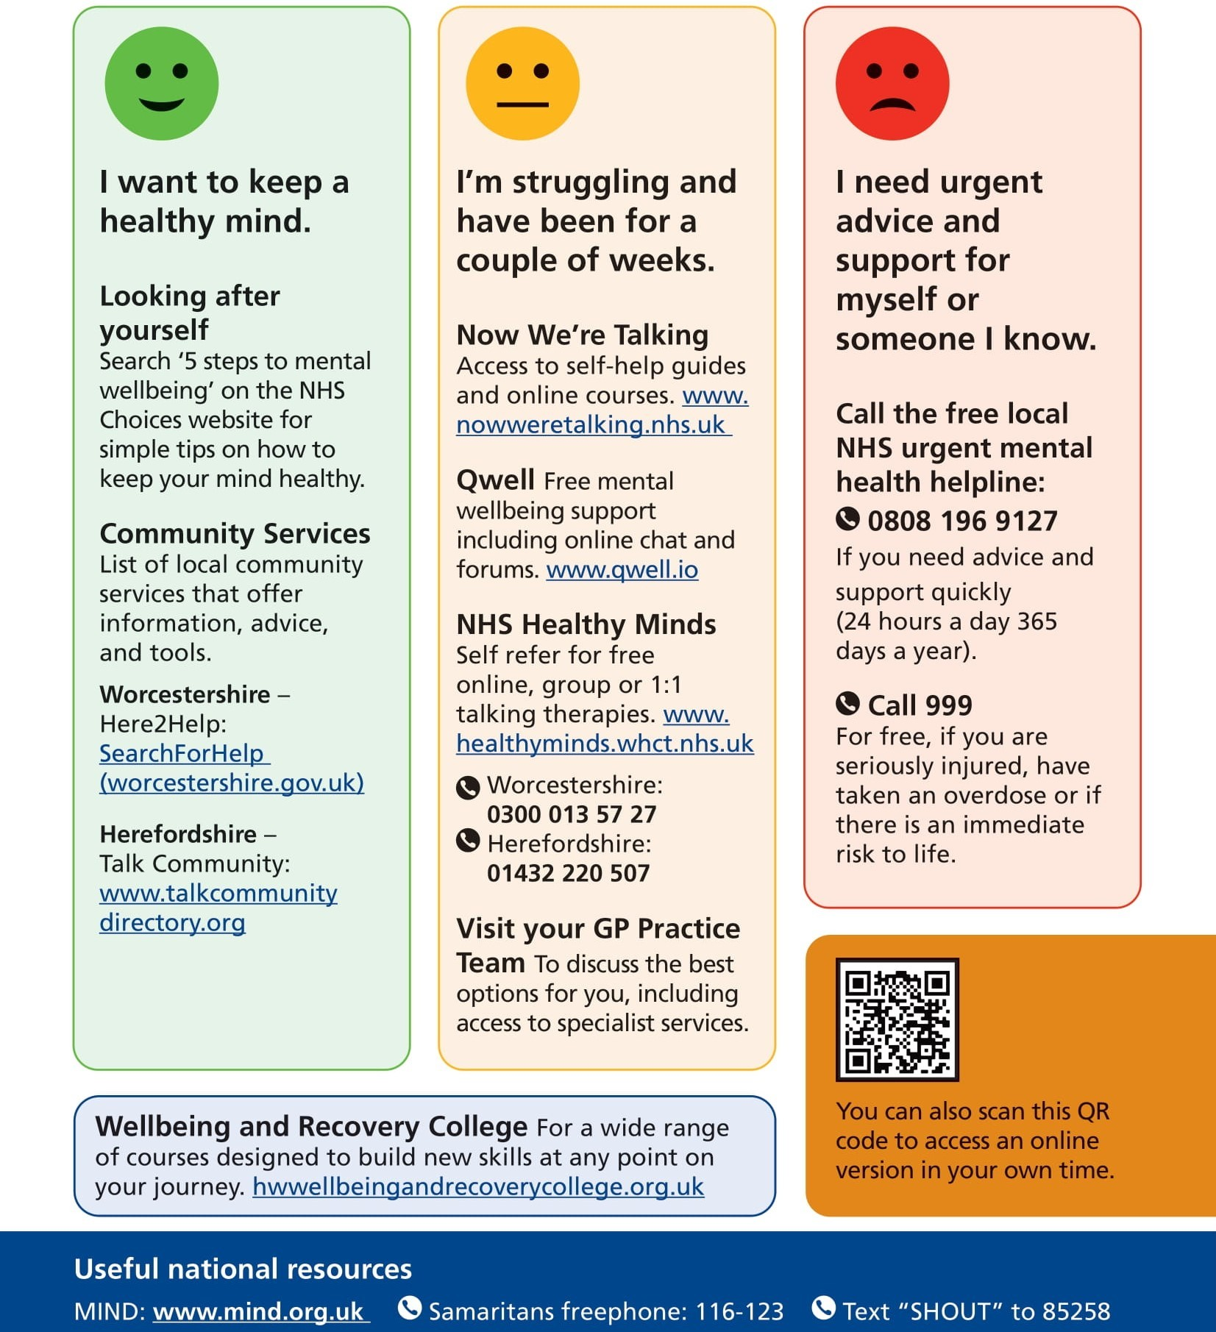
What support will there be for my child’s overall well being?
As part of a wider team including external professionals and the Trauma Informed Practitioner, students can be referred to receive Wave 2 and above, graduated response support.
Staff run many interventions from personalised to small group work. e.g., self-esteem, social skills, emotional well-being, self-harm, positive self-image sessions
The Pastoral and Learning support teams provide daily support for those students who need “a chat”, a soft start to the day or a catch up at the end of the school day.
Each Form Tutor expects to provide outstanding pastoral and wellbeing care as part of their responsibilities.
The LRC is a wellbeing space at break and lunchtime: all students are welcome
Learning4Life and PSHE lessons are delivered weekly alongside themed assemblies and outside speakers
The Learning Support team work tirelessly with the EWO and attendance team to break down barriers to attendance including mental health and wellbeing
For Safeguarding / Child protection issues. members of school staff are Designated Child Protection / CSE trained officers, including the Director of SEND. Extremism and Radicalisation are also monitored
Specialist External Agencies/ Health Care Professionals also support students as required to services such as:
CAHMS
WEST
School Nurse
Cranstoun substance advice
YMCA Mentoring
Pet Assisted Intervention
CRUSH and RESPECT
Return to ‘quick links’

Slide 29
What training have the staff supporting SEND had or what are they having?
Learning Support staff ensure that all staff are aware of students’ specific special educational needs with specific supportive strategies in our Staff Shared Area.
Student's SEND passports or SLIPS are written and distributed to provide strategies for teaching and support staff to ensure that the appropriate support is put in place.
There is a full programme of CPD training for all staff to participate in and specific training is identified through the Performance Management process.
INSET Days are used for whole school, department and individual SEND training when identified. This thorough training programme ensures Governors and teachers understand the strategies to support and identify vulnerable students and their knowledge of SEND is up to date. This training is run by school staff and outside speakers with specialist experience as well as by external agencies.
Achievement Assistants work with teaching staff to ensure that students with SEND can access the curriculum.
Exam Access Arrangements: Annual training for Invigilators and Achievement Assistants (taken by the Exam Manager)
The Director of SEND holds the Post Graduate Certificate in the National SENDCo Award
Ongoing Staff Briefings to disseminate information on key strategies for areas of need led by specialist staff
Time is allocated each term for a regular CPD update to staff by the Curriculum and Pedagogy and Learning Support Team to develop the adaptive teaching approach
EVAC Chair training is completed by all staff and updated annually
Return to ‘quick links’

Slide 30
How accessible is the school both indoors and outdoors?
Our Accessibility Plan is updated formally every 3 years.
It is a working document written by staff, parent/carers, and pupils with any access or medical need.
Building alterations are considered with any new cohort and 2022 saw several construction adaptations around the school to widen doors and add push button door openings.
This enables all students with any access need to be or to increase their independence in preparation for adulthood post school.
Our accessibility plan 2022 to 2025 can be found on our school website.
Return to ‘quick links’

Slide 31
How are parents involved in the school? How can I get involved?
Arrow Vale will provide a key assessment report on progress two to four times a year.
Where a student is receiving SEND/EHCP support, the SEND Team will be in contact with parent/carers regularly to talk about their young persons' needs and the activities and support they will receive to help them make progress and formally, 3 times per year to share passport / SLIP updates.
Parents are encouraged to share all relevant information – you know your young person best!
These discussions will help us identify the responsibility the parent/carer, student and the school have towards the best statutory outcomes for the student. We hope that these discussions will strengthen the impact of the support we give in school by increasing engagement.
If we think a student with SEND needs extra support from or referral to outside specialists, parents/carers will always be asked for their signed permission.
Children with SEND who are also Looked After will have meetings in school in relation to their PEP (Personal Education Plan) every term. This is led by the Heads of Year and the Virtual School
Community Café invites are sent each term, where parent/carers are given the chance to be fully involved with discussions and ideas for improvement
Return to ‘quick links’

Slide 32
How do children contribute their views about their support and who can help them? (Page 1)
Students will always be included in discussions about their needs, targets and progress through ownership of SLIP or passport.
Students with SEND will always have a safe and inclusive area to go to within Arrow Vale if they are not happy or have particular worries or concerns e.g., Form Tutor – HOY / YTL, LRC, Emotional well-being team, Learning support / Key Workers.
Students with SEND will regularly attend interventions and social sessions in these areas and will know all the staff team very well. Students will always have someone to talk to. This will ensure their views are heard and incorporated into their targets.
Return to ‘quick links’

Slide 33
How do children contribute their views about their support and who can help them? (Page 2)
Students…
Are consulted regarding exam venues when supported by medical evidence is upheld / based on need.
Can express their preference for the gender of their trusted adult (Achievement Assistant) for their own personal care needs.
Provide student panels for interviews, visits and tours of the school
Have an opportunity to express their Student Voice prior to and during every EHCP annual review
Are part of whole School Council meetings held each term or as needed.
Are used as guides for visitors on Open Evening every September.
Meet with their Form Tutors to talk about progress, achievements and to review any targets
With an EHCP are set targets in line with their outcomes in these statutory documents that are monitored termly
Return to ‘quick links’

Slide 34
What specialist services are available or can be accessed by the school?
CRST Specialist teachers in Autism, dyslexia and Social, Emotional and Mental Health alongside an EHCP specialist
SENDIASS: Special Educational Needs and Disabilities Information and Support Services
SEND Supported: Specialists in Cognition & Learning, Autism and SEMH
Umbrella Pathway – Autism Assessment
Community Paediatrics – ADHD Assessment
Worcestershire County Council
EHCP Assessment and consultation
Educational Psychologist
CAMHS – Child and Adolescent Mental Health Services.
The Wellbeing and Emotional Support Teams (WEST) in schools service is designed to help children and young people ages 5-18 years access mental health and wellbeing support early on in educational settings
Specialist mentoring from outside Youth Groups such as YMCA, Wallop Boxing and Pet Assisted Psychotherapy
Return to ‘quick links’

Slide 35
How will the school prepare and support my child when transferring classes or schools? (Page 1)
Transition is a part of life for all learners. Arrow Vale works with schools, colleges, universities and other settings to support students through positive transitions from one educational setting to another/ phases of education and in preparing for adulthood.
If your child is moving from middle to high school, we will work with the SENDCo and class teacher/transition lead at their Middle school to ensure that we understand your child’s needs and can plan for them when they move to us. Sometimes we will attend annual review meetings at middle schools and specialist service / professionals’ meetings to help us gather all the relevant information. We will also arrange extra visits to Arrow Vale to help with your child’s transition, and a specific SEND transition day is also held.
As students approach the end of their time at Arrow Vale, we work with them to ensure they have high aspirations about employment, College courses and higher/further education, independent living and participation in society. Discussions about students’ futures will focus on what they want to achieve and the best way we can support them. Helping them consider the right post-16 option is part of this planning. University visits are also arranged.
We may help arrange work experience and work-based placement and assist with travel arrangements if required.
Return to ‘quick links’

Slide 36
How will the school prepare and support my child when transferring classes or schools? (Page 2)
In Year 11 the school will work to ensure students have firm plans for their post-16 options.
Any information about previous SEND provision will be shared with the Higher/Further education or training provider.
We are always proud of the 0 % number of NEETS for SEND students.
We also use our CAIEG Coordinator with various events and experiences throughout the year.
We also refer to the Post 16 Coordinator employed by SENDIASS. We also have a Post-16 Specialist AA who supports students to find the right next step in Education or Apprenticeship
Return to ‘quick links’

Slide 37
Who can I contact for further information or to complain about SEND issues?
Dealing with complaints: a copy of the Complaints Policy is available on the school website.
Arrow Vale School | Part of Central Region Schools Trust (arrowvaleacademy.co.uk)
If a parent/carer wishes to complain about the SEND provision or the policy, they should in the first instance, raise it with the Director of SEND.
If the issue can’t be resolved within 10 working days, the parent can submit a formal complaint to the Principal / Chair of Governors in writing or in any other accessible format. The Principal will reply within 10 working days.
Any issues that remain unresolved at this stage will be managed according to the school’s Complaints Policy. This is available from the school website.
Return to ‘quick links’

Slide 38
Further Information about the 4 broad areas of special educational needs follows in a separate document ‘AREAS of NEED’ Each need is unique in their symptoms and barriers, and some pupils will have traits across several needs (neurodiverse).

