Slide 2
Principal’s Address
Mat Rash

Slide 3

Offering Real Choice
Ofsted – October 2024
“The school has designed a highly ambitious curriculum for all pupils, including pupils with special educational needs and/or disabilities (SEND) and students in the sixth form. The school has set very high expectations for pupils’ future academic achievements”.

Slide 4

Offering Real Choice
Ofsted – October 2024
“All pupils and sixth-form students receive unbiased information on potential next steps and high-quality careers guidance. This prepares them extremely well for the next stages of their lives”.
“Pupils understand and share the school’s aspiration to aim high”

Slide 5



Aim High

Slide 6
Options Process
Scott Crane
Vice Principal

Slide 7
AIM
Ensure all students choose options which they will enjoy, achieve success in and importantly gain qualifications which allow progression.

Slide 8
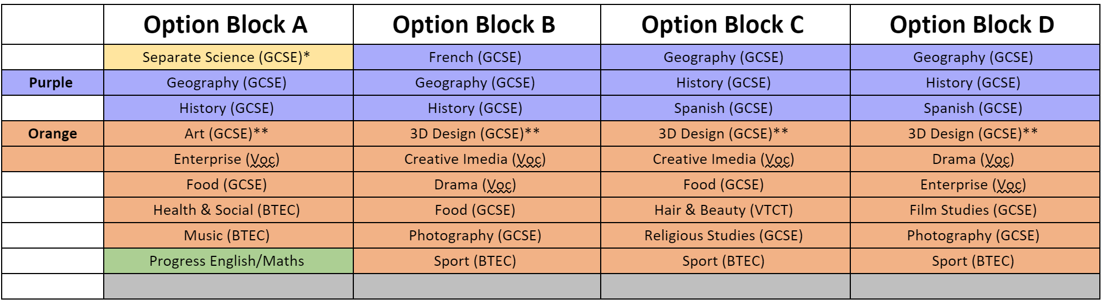
Option Blocks
Recommendations made to ensure all students enjoy and succeed.
All students will complete English x2 Maths and Science x2
Ebacc – History, Geography, French or Spanish (Purple). Used as a school performance measure and desired by Russell group Universities
Other high-quality qualifications (Orange)
Separate Science GCSE x3 (Yellow – recommendation only)
Progress English/Maths Green (recommendation only)

Slide 9
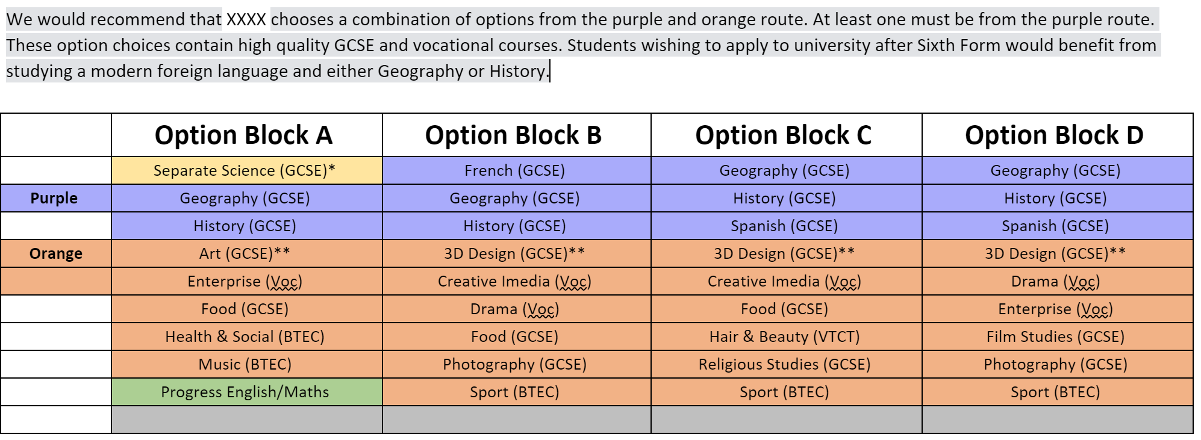
Completing the planning form
Read your recommended route
Visit the subjects you are thinking of taking. After tonight, use the curriculum booklet provided to read about the subjects, their course content and the way in which students are assessed
Do not make choices based on your friends/teachers

Slide 10
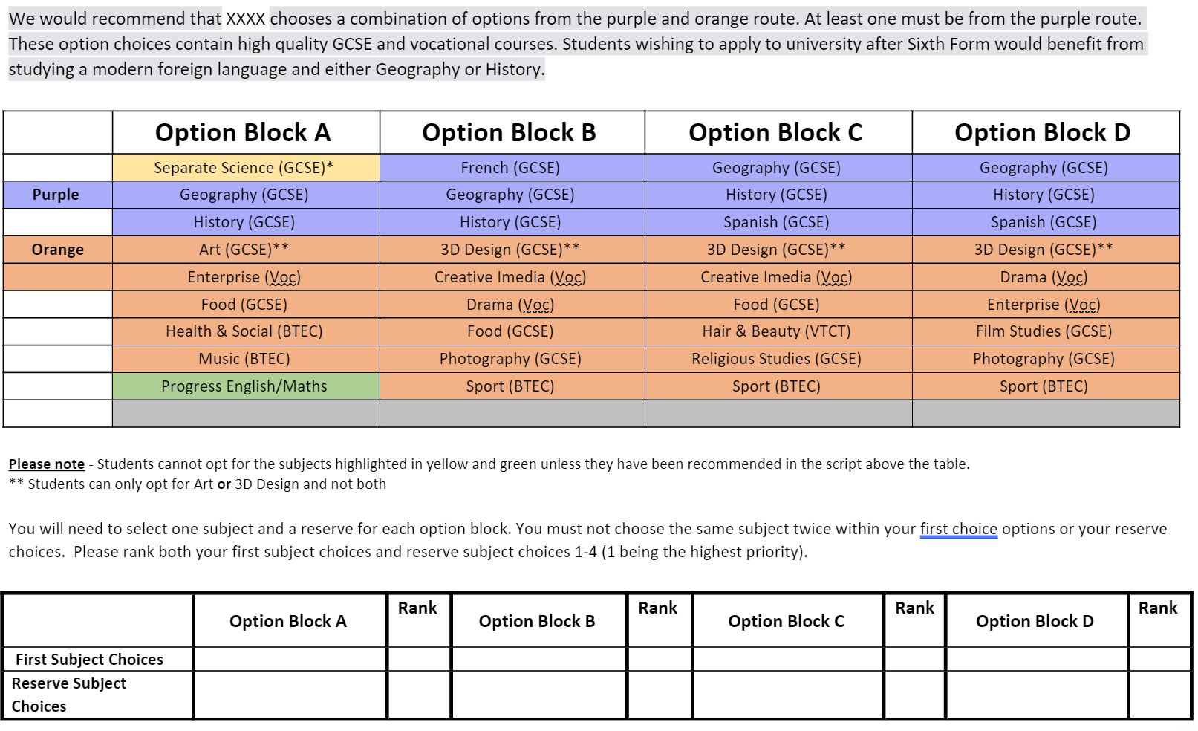
Completing the planning form

Slide 11
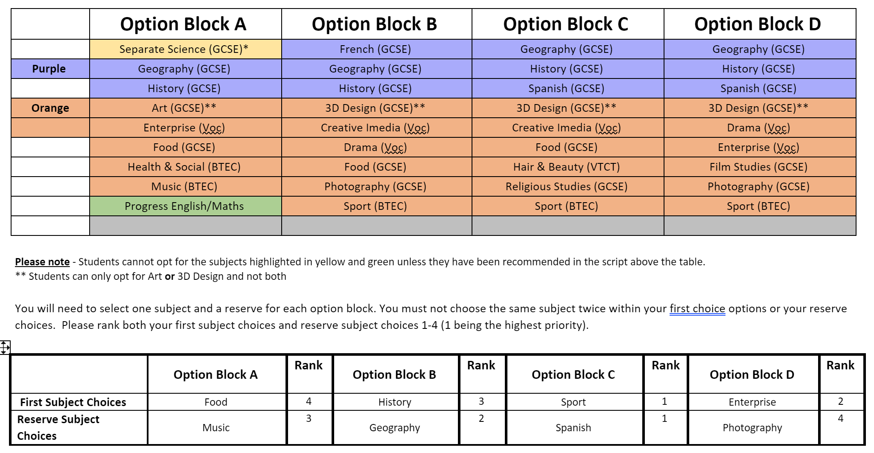
Completing the planning form

Slide 12
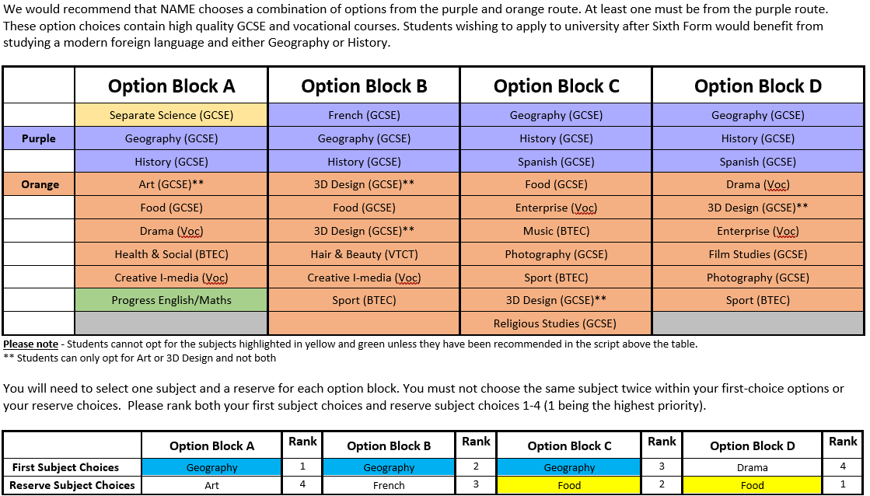
Example of incorrect completion

Slide 13
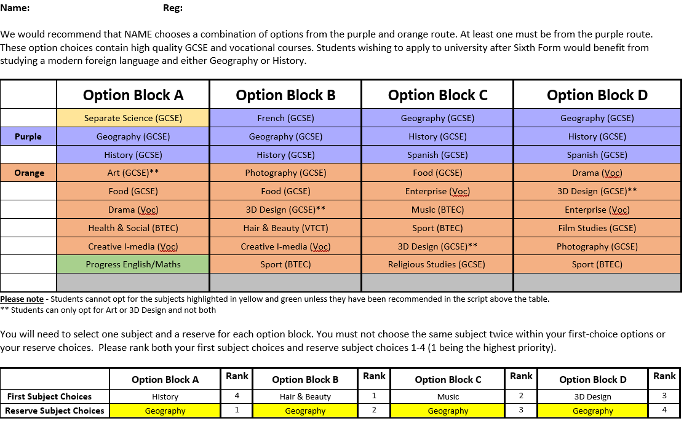
Example of incorrect completion

Slide 14
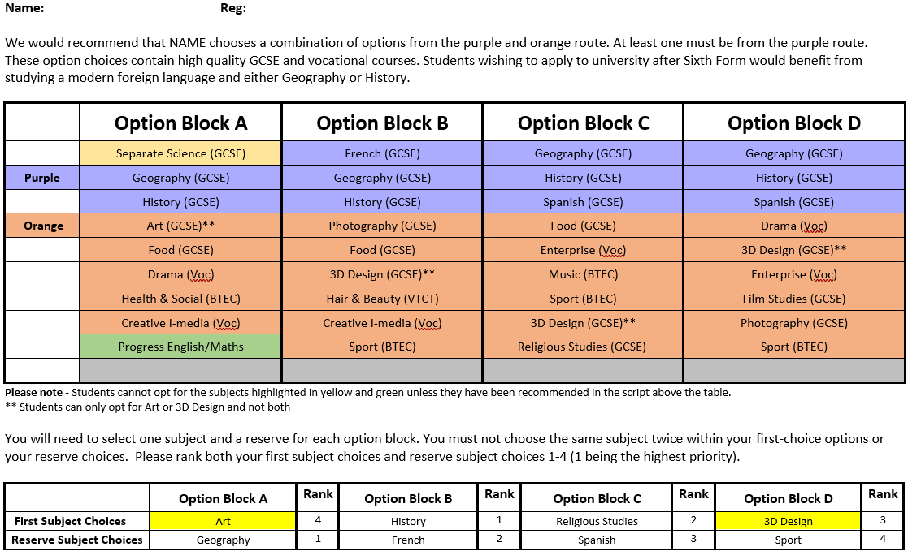
Example of incorrect completion

Slide 15
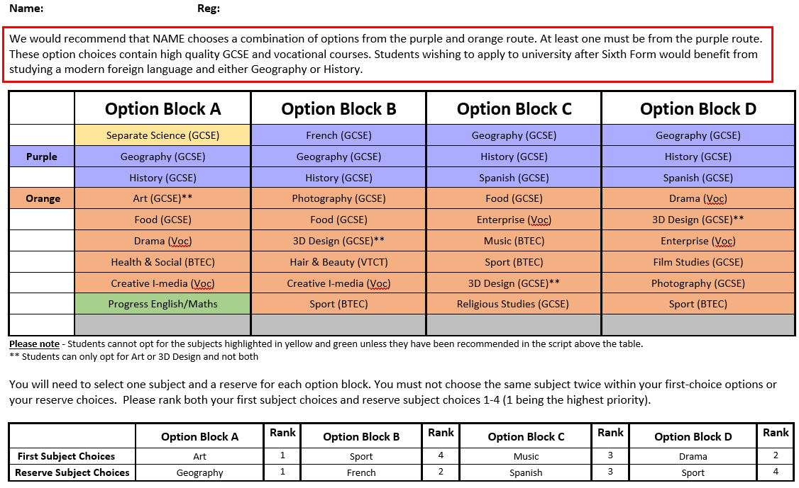
Example of incorrect completion

Slide 16
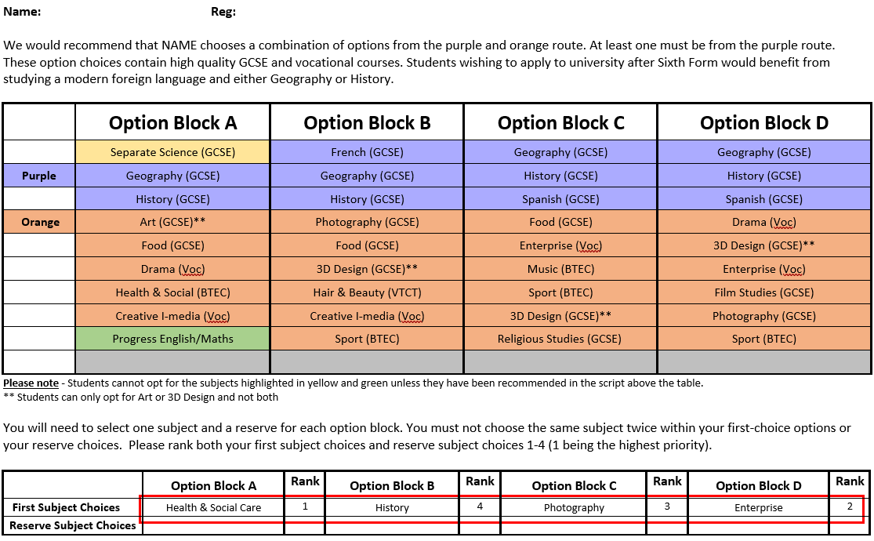
Example of incorrect completion

Slide 17
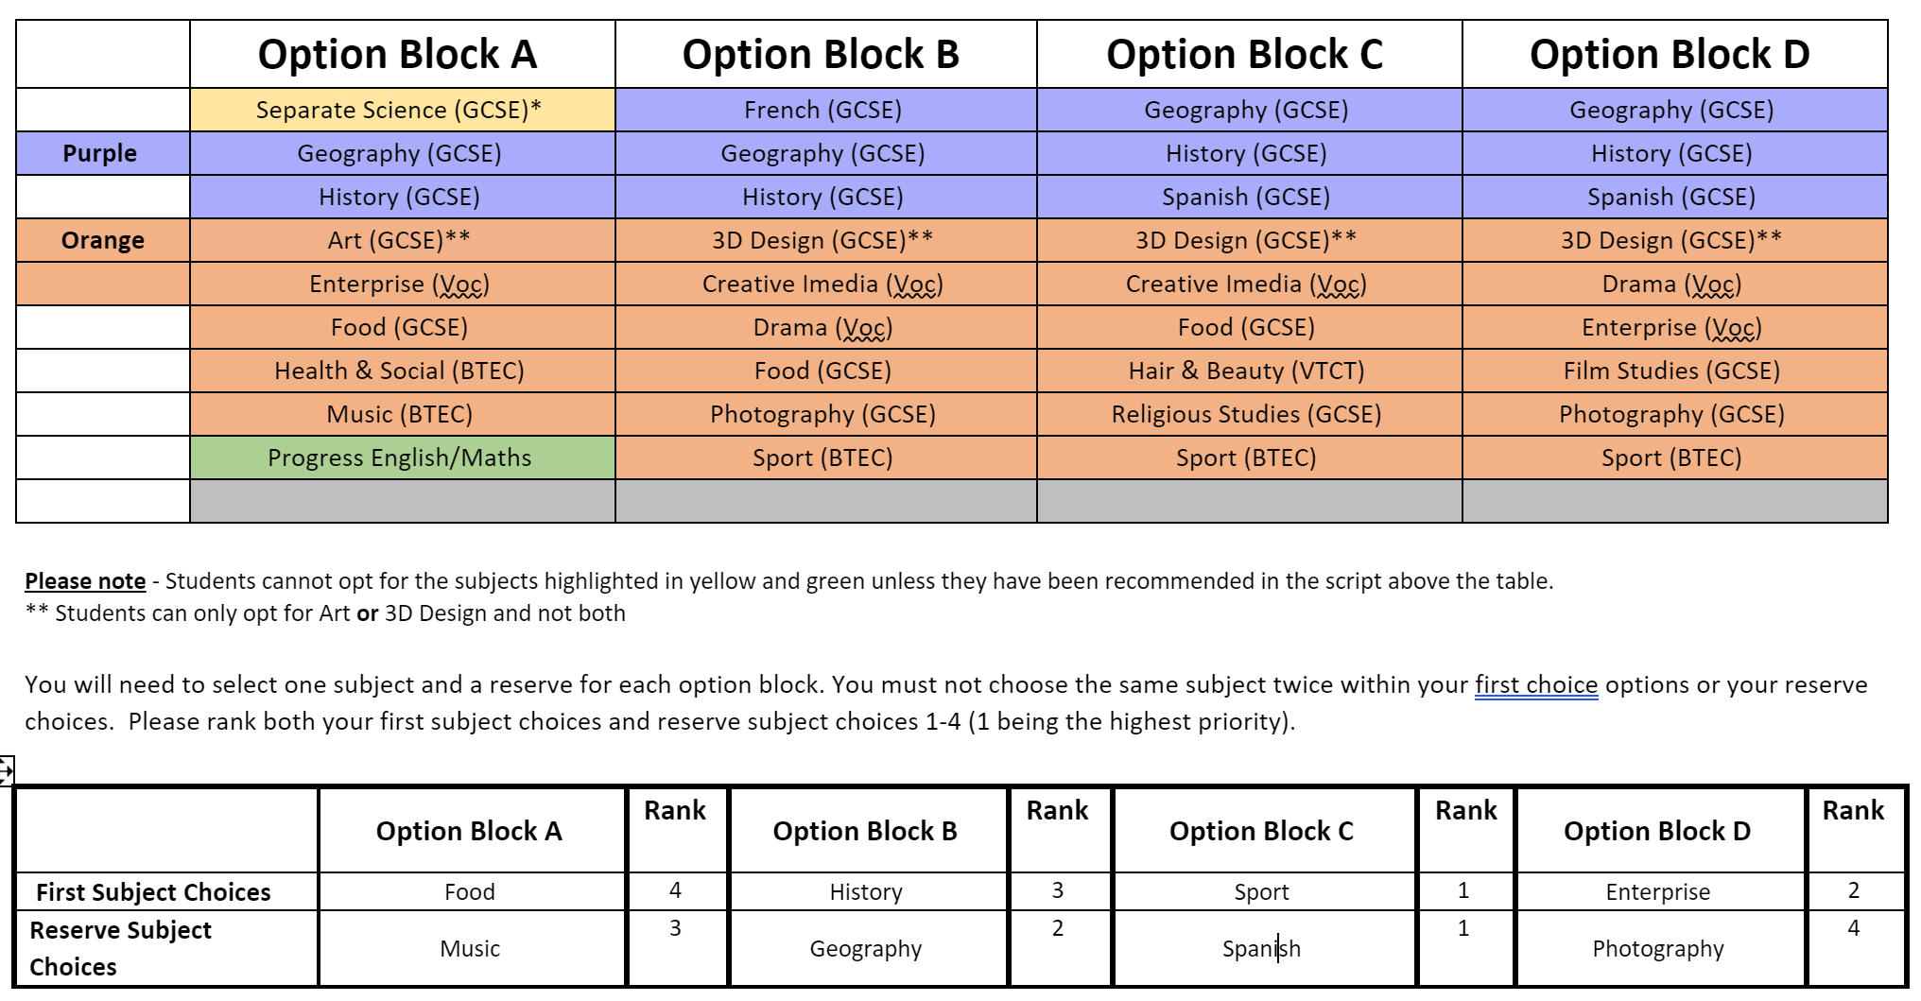
Example of correct options planning form

Slide 18

Submission of Options Choices
Ensure your completed ‘planning’ form has a different first choice subject in each option block
Ensure your completed options form has 8 subjects identified
Ensure you have completed the ranking information and that you have selected courses for the right reasons
Remember that you cannot choose Art and 3d Design

Slide 19
Submission of Options Choices
Once you are happy that you have planned your options choices correctly you will need to access the QR code to submit your final choices via the online form. QR codes can be found on the planning form
Options are not allocated on a first-come, first-served basis
Please note that once the form is submitted, you will only be able to change option choice requests by emailing options@arrowvaleacademy.co.uk
The deadline for submitting option choices is Friday 4th April
Be aware that most students will be allocated one of their reserve choices, due to limitations on group sizes etc.

Slide 20
Queries about option choices
In the first instance, any queries should be raised with your child’s form tutor
If the query cannot be answered by your child’s form tutor, then please email options@arrowvaleacademy.co.uk

