Slide 1



Year 11 Exams Information Evening
4th September 2025

Slide 2

Key Dates
Thursday 16th October - Sixth Form Open Evening –
Monday 13th October – 7th November (with Half Term in the middle) – November Mock Exams
Tuesday 13th January – Year 11 Parents Evening
Monday 10th February – 28th February (with Half Term in the middle) – February Mock Exams
Thursday 27th March – Exams Information Evening
Wednesday 6th May – External Exams begin
Friday 26th June – Final exam

Slide 3


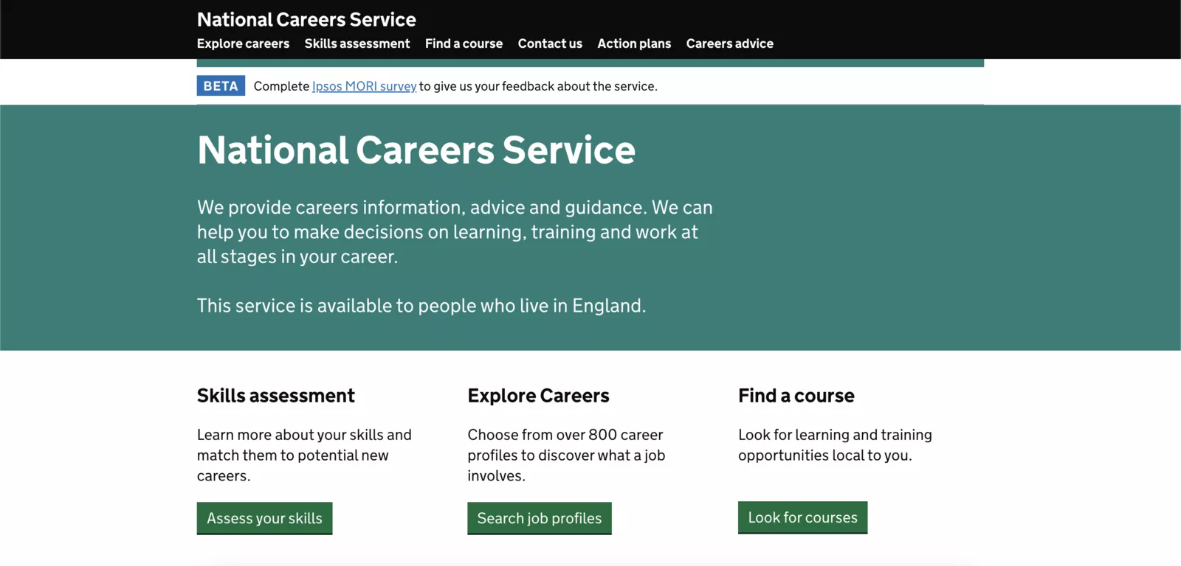
Why are we doing this?
Exam preparation is important because it not only helps us perform well on the exam but also teaches us valuable skills that we can use throughout our academic career and in the work force.
The key advantages of preparation are:
A Higher Chance of Success
Better Memorisation Skills
Reduced Stress Levels
Better Time Management Skills
Better life chances!
How parents can support
The National Careers Service provides anyone aged 13+ with lifelong careers information, advice and guidance to help you make good career choices, no matter what point of your career.
Their website offers valuable tools to help you establish where your interest, skills and qualifications could take you, regardless of starting point.
http://NationalCareers.Service.gov.uk

Slide 4
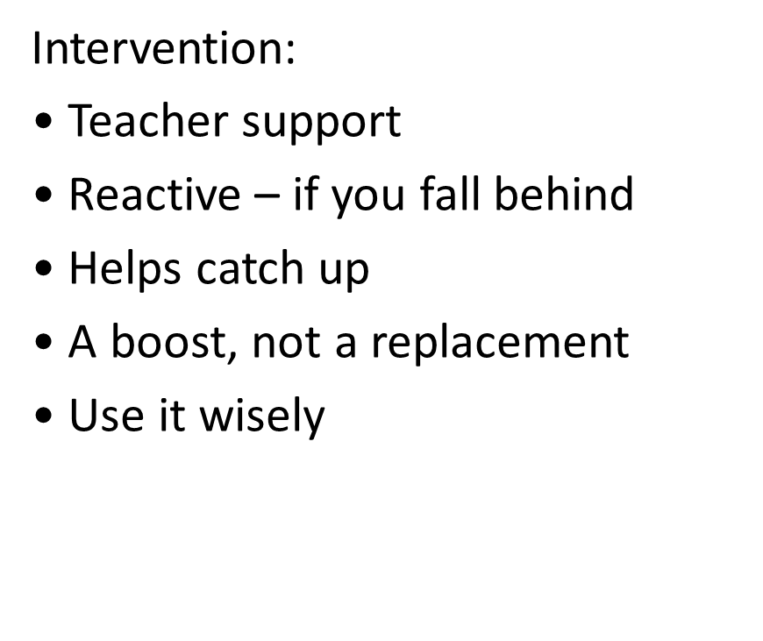
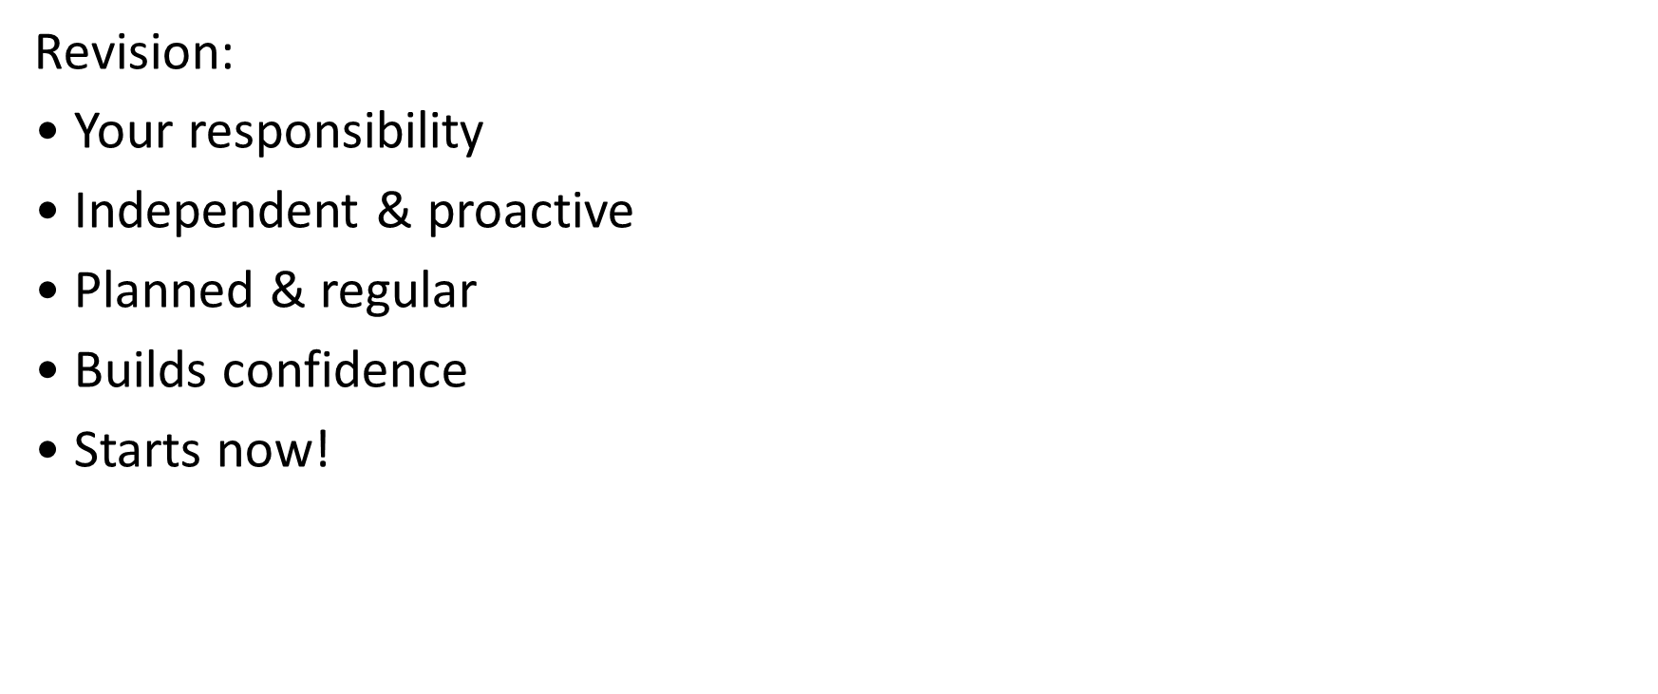
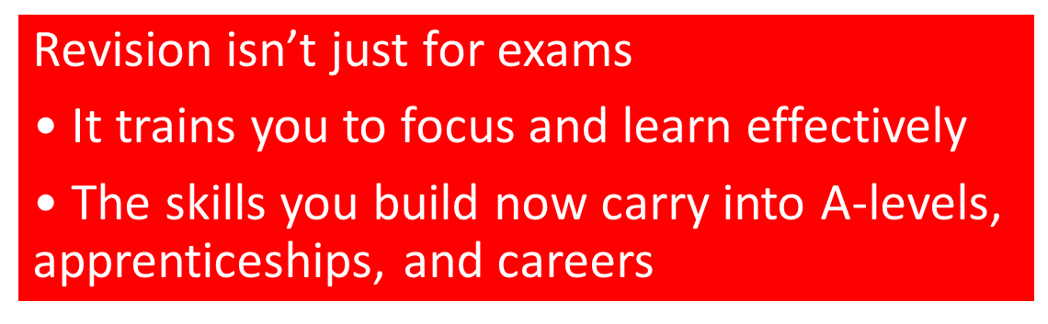


Revision & Intervention
AM Intervention
English, Maths or Science. 3 x 25 minutes per week
PM Intervention
Presume school finishes at 4pm every day!
Selected students – welcome

Slide 5
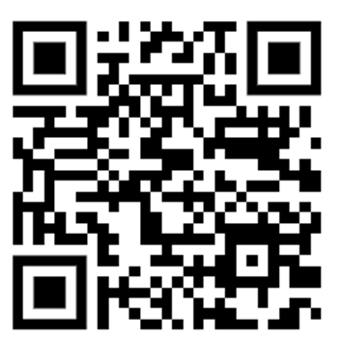
Pearson Revise
All students have free access to Pearson’s online revision guides. A link to this site can be found on Edulink or they can simply log in at:
https://reviseonline.pearson.com/school/crst
You will need to know the subjects and the examination boards for each of your courses to ensure you are accessing the correct revision material:
Subject | Exam Board and Notes
English Language | AQA
English Literature | AQA Macbeth, A Christmas Carol, Power and Conflict poetry set, An Inspector Calls
Mathematics | Pearson Edexcel
Double/Triple Science | AQA
History | Pearson Edexcel Medicine, Elizabeth, Cold War, Germany
Geography | AQA (8035)
French | AQA
Spanish | AQA
Religious Education | Pearson Edexcel
Food | WJEC – Food Preparation and Nutrition
Film | WJEC
Art & Design – Fine Art | AQA
Art & Design – Photography | AQA
Art & Design – 3D Design | AQA
Health & Social Care BTEC | Pearson
Sport BTEC | Pearson
Creative iMedia | OCR Cambridge National
Enterprise | OCR Cambridge National
Hair & Beauty | VTCT Level 2
Music BTEC | Pearson
Drama BTEC | WJEC – Performing Arts
Further Maths | Pearson Edexcel Level 2 Certificate

Slide 6

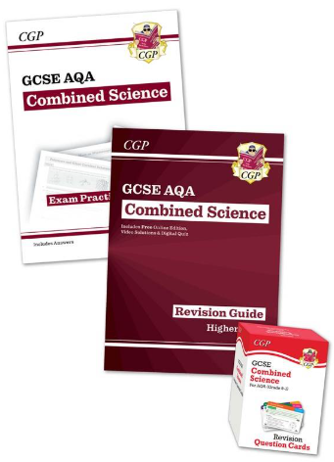
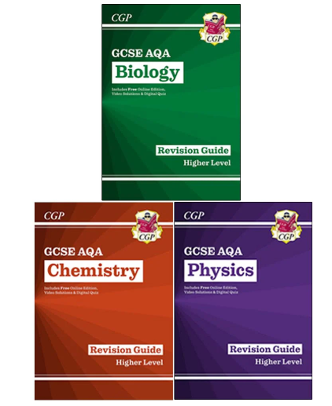
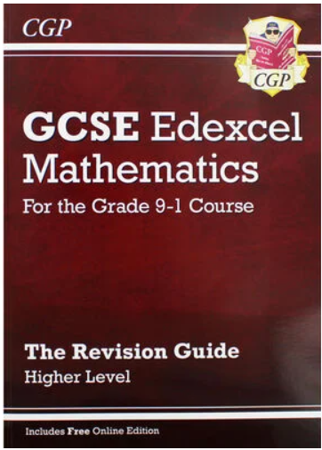
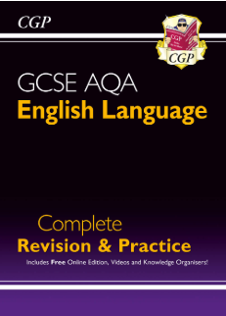
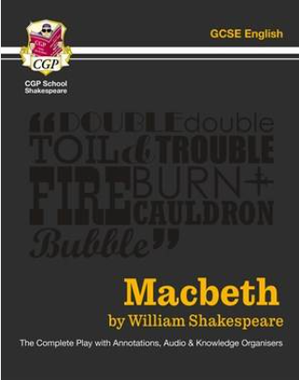
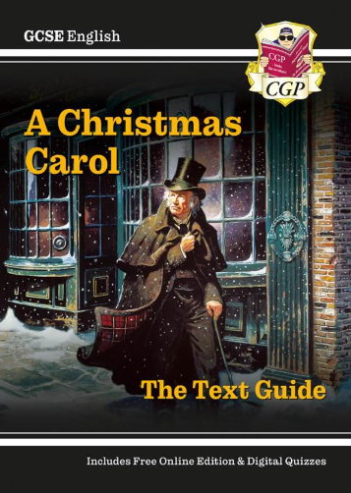
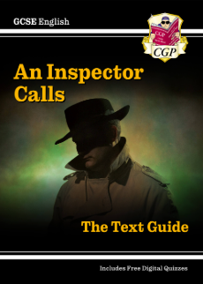

Revision Guides
Science:
We recommend CGP revision guides for our AQA Combined (double award) and Separate (triple) award. The revision guide is the most useful, however they do sell a complementary workbook and flash card set which some students have found useful. These are available on ParentPay.
Separate Science (available in higher and foundation)
Combined Science (available in higher and foundation)
Maths:
We recommend CGP revision guides for our Edexcel Maths award. This is available for Higher and Foundation tier.
English Language:
We recommend CGP revision guides for our AQA English Language award.
English Literature:
GCP’s ‘Macbeth: The Complete Play’ is one of the best revision sources for this Shakespear play. You will find a full annotation of each scene, alongside descriptions in modern English to increase understanding. We also recommend CGP Text Guides to support the revision of An Inspector Calls and A Christmas Carol. The ‘Power and Conflict Poetry Guide’ will support the revision of the poetry aspect of this course.

Slide 7
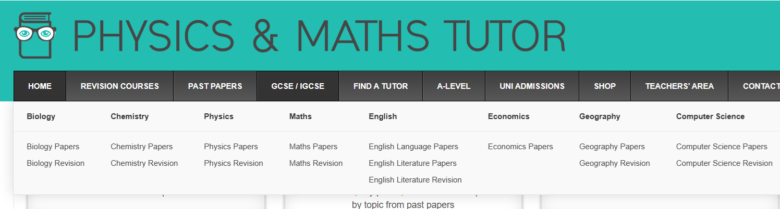
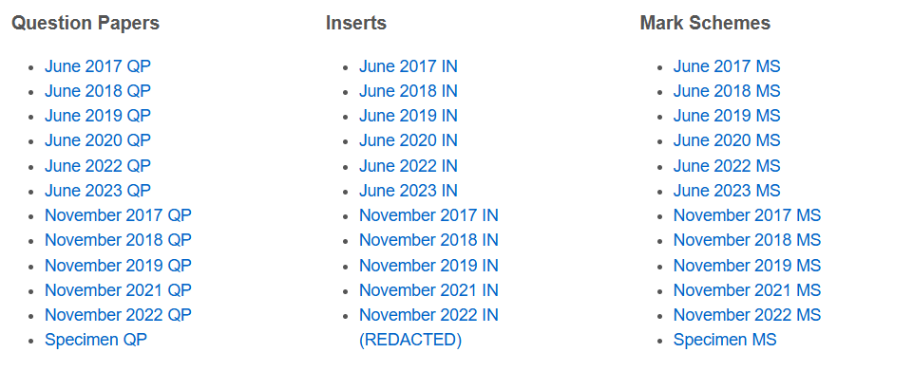
Past Papers and Mark Schemes
Physics and Maths tutor is the easiest place to access past papers and marks schemes, for all subjects including:
Science
Maths
English Language
English Literature
Geography
GCSE/iGCSE
Past papers
Go to website: www.physicsmathstutor.com
Click ‘GCSE/iGCSE’
Select subject
You will then be asked to select your exam board for that course (see page 4) and what paper you’d like to focus on.
You will land on a page like this, where you have free access to all past papers and mark schemes for your chosen subject.

Slide 8
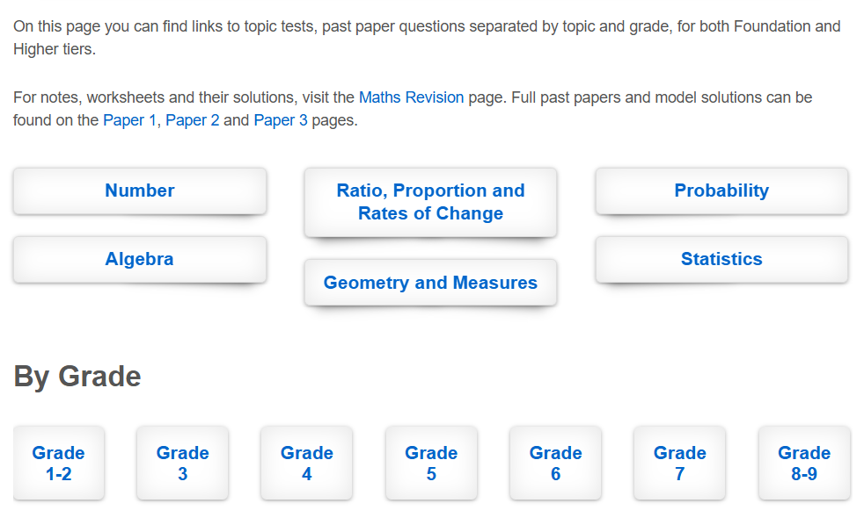
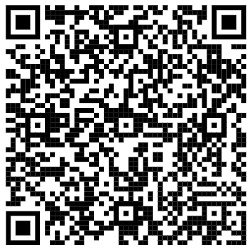
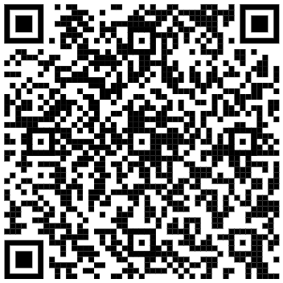

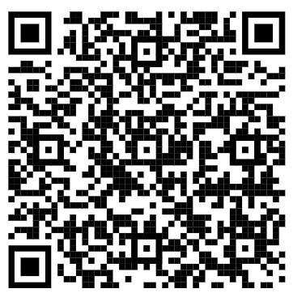
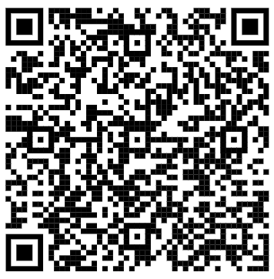
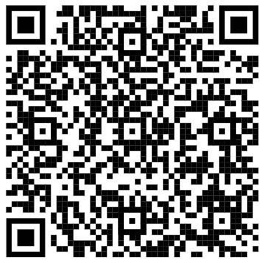
Specific exam questions:
Physics and Maths tutor is the easiest place to access exam questions for individual units/modules/chapters within some subjects.
GCSE/iGCSE
Revision
Math's Example:
Broken down in to specific units or by grade
Maths | Geography
Biology | Chemistry | Physics

Slide 9
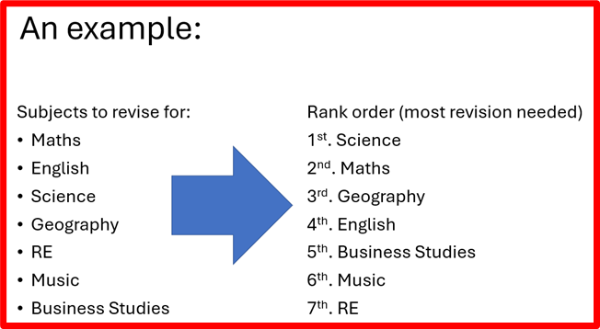
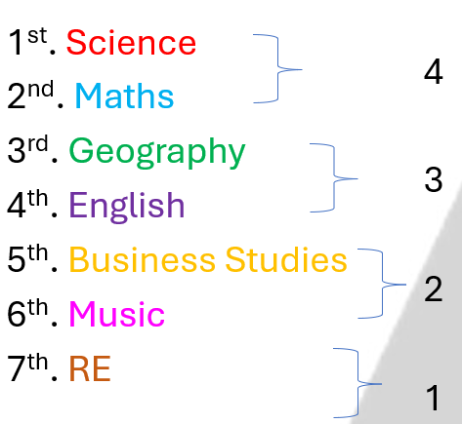
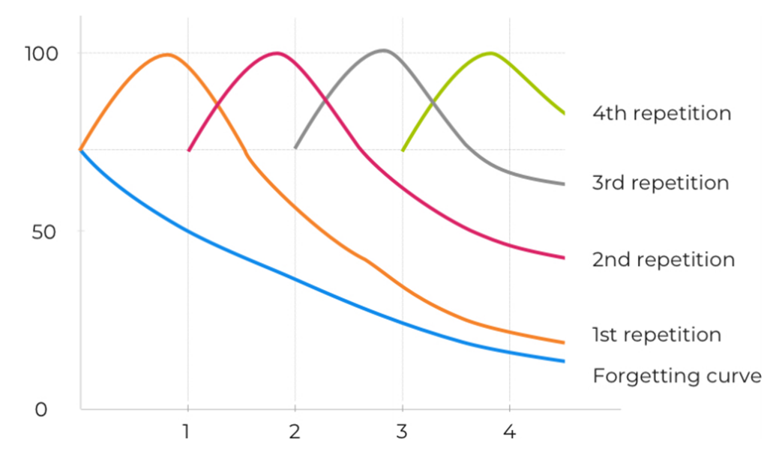
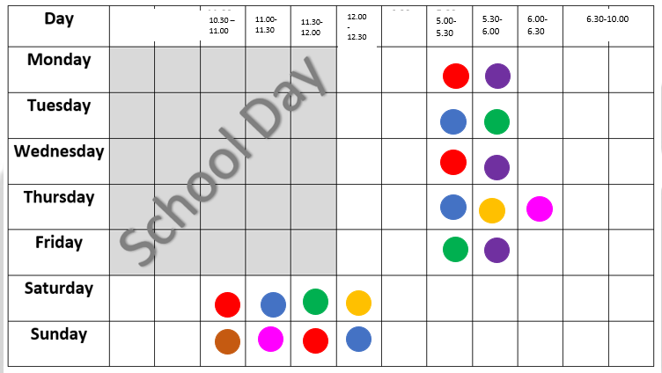
Building a Revision Timetable
1.List all the subjects that you need to do revision for.
2.Now rank them in order, with the first being the subject in which you need to do the most revision.
Think about your target grades and current attainment to work this out. Discuss with teachers if you need
3.Decide how many 'sessions' of revision a week you can do, and how long each session will be.
4. Allocate how many sessions you will dedicate to each subject (the higher the rank, the more sessions needed)
5. Plat subject sessions of a timetable, ensuring that they are 'interleaved', giving pupils time to 'forget' in-between.

Slide 10
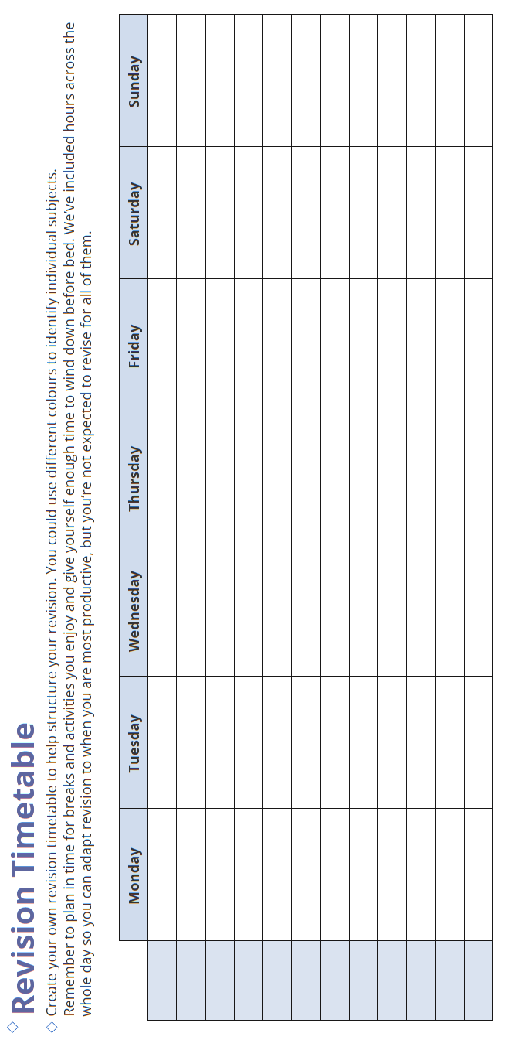

Slide 11
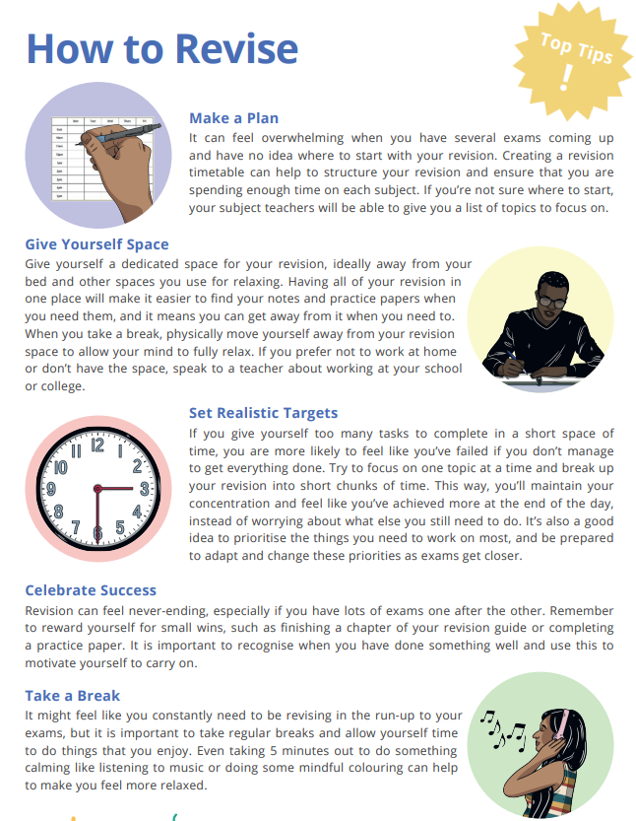

Slide 12
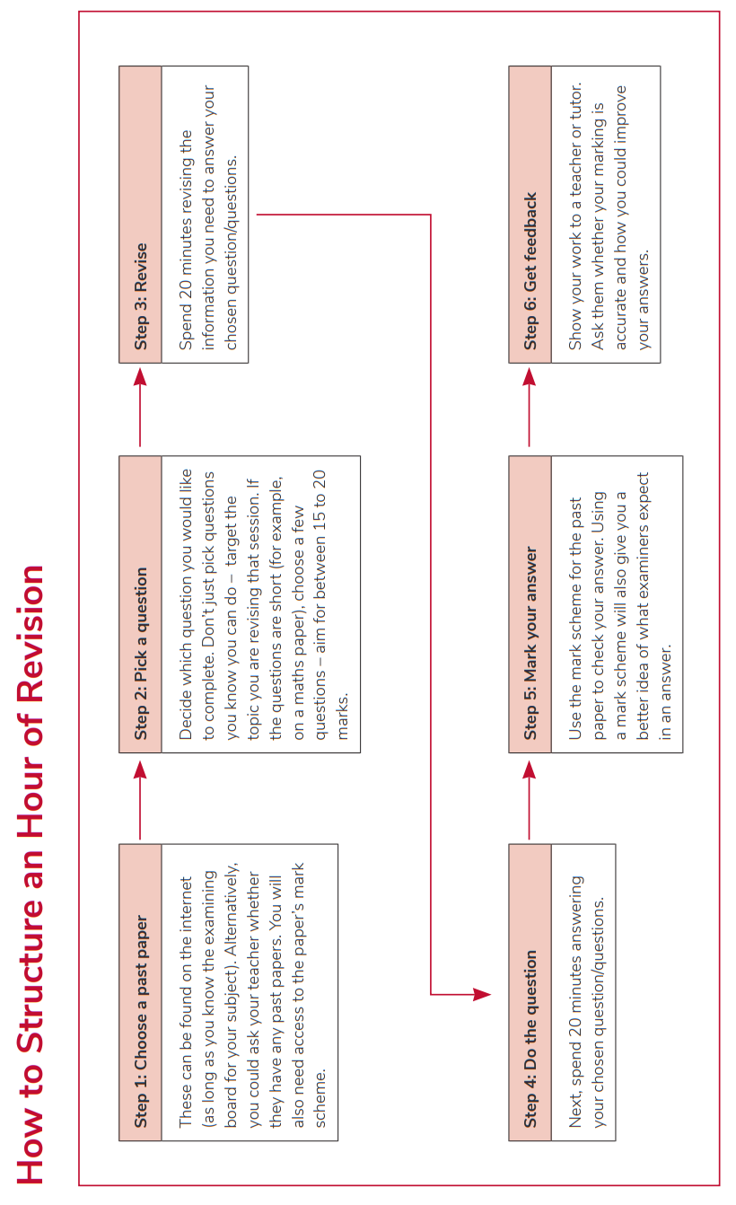

Slide 13
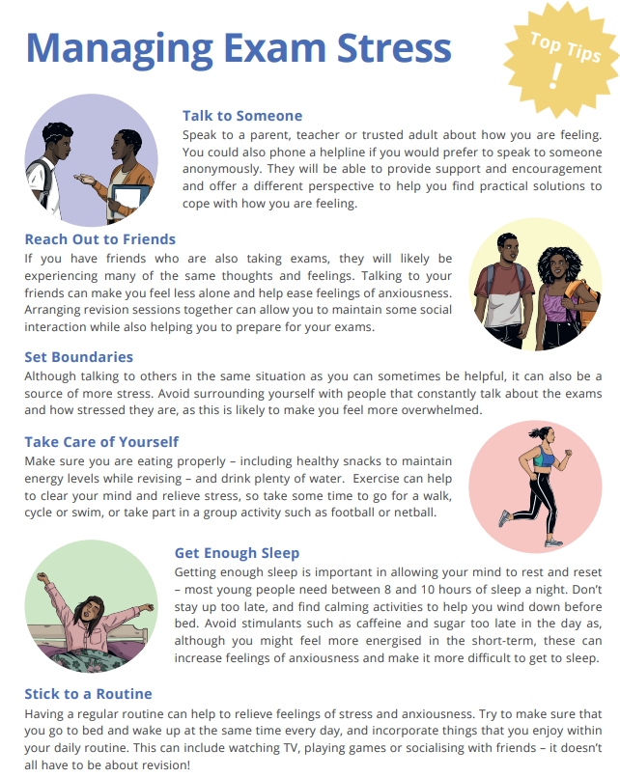

Slide 14

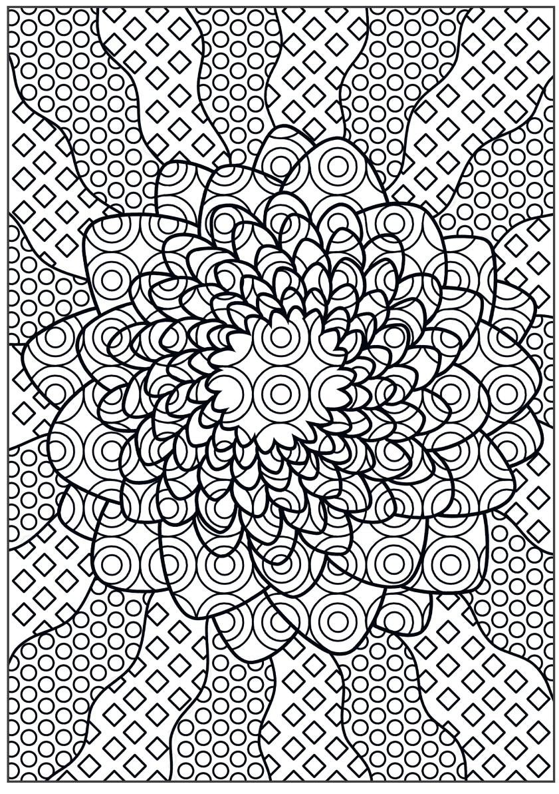

Slide 15
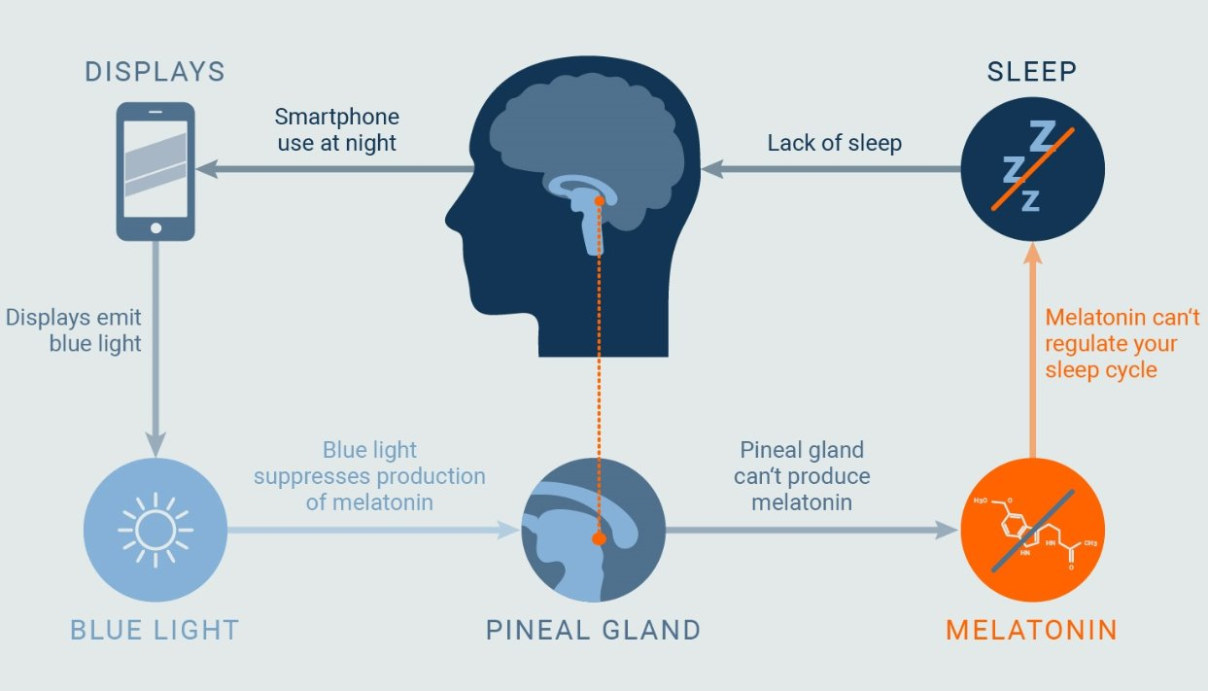
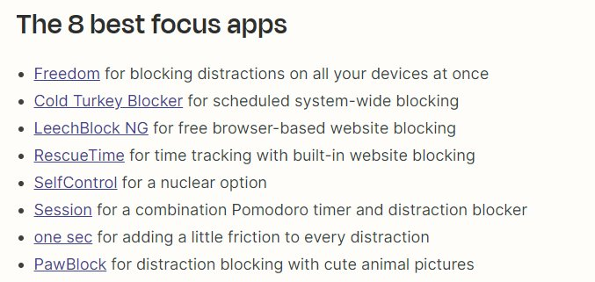
The Importance of Sleep
You need 6 sleep cycles a night to repair, grow and consolidate new information and knowledge​
A sleep cycle for teenagers lasts approximately 1.5 hours​ (they need a total of 9 hours sleep)
You need to be mindful of the delay extrinsic factors, such as gaming, scrolling and social media have on how long it takes you to go to sleep, and factor that in.

Slide 16


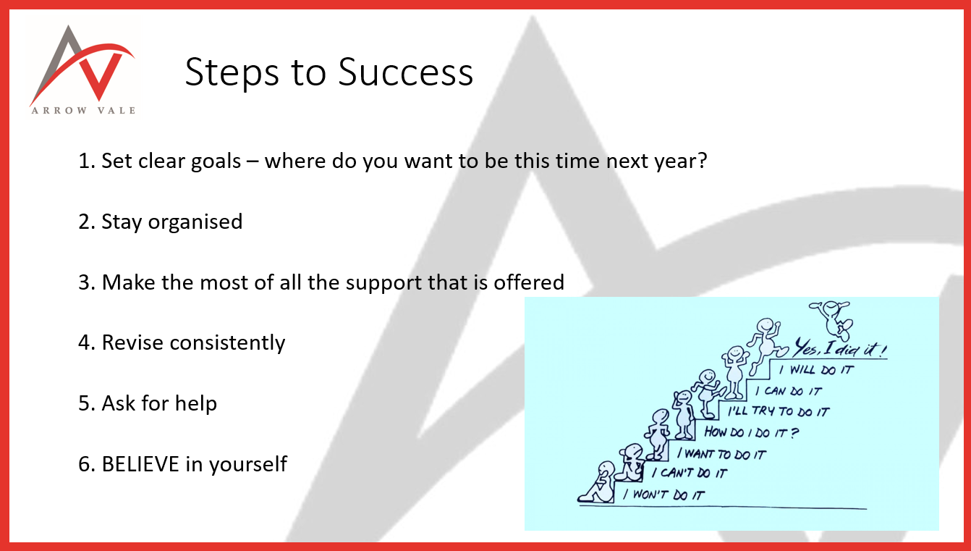
Key Messages from Year 11 Introduction Assembly

Slide 17
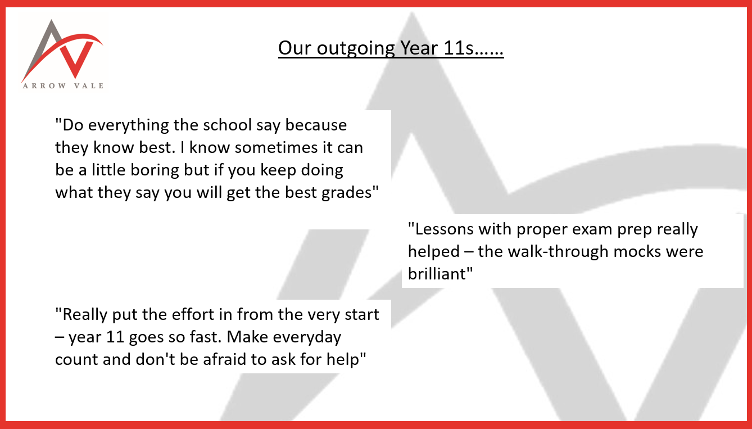
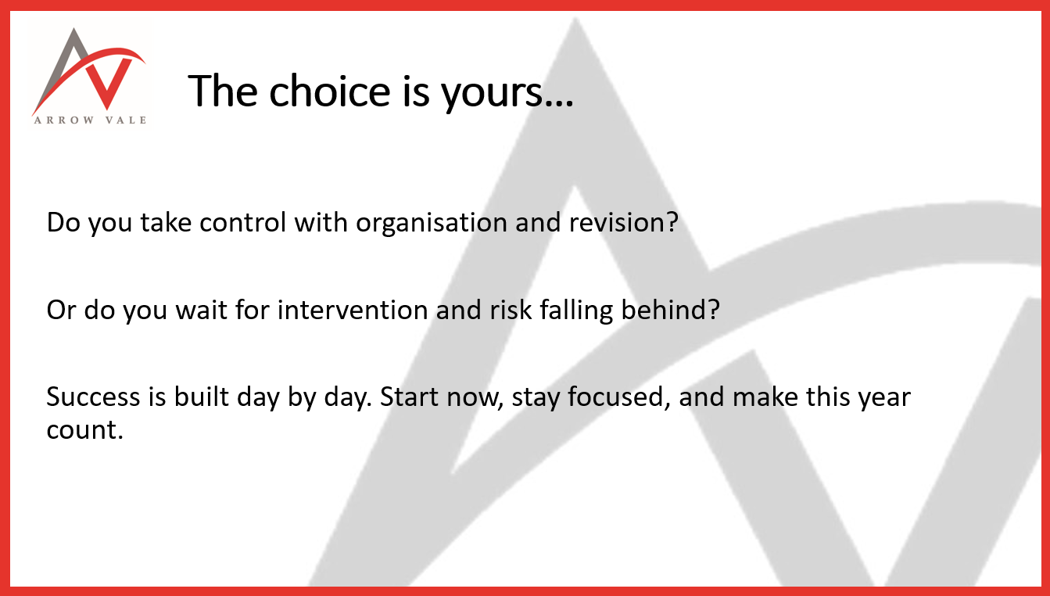
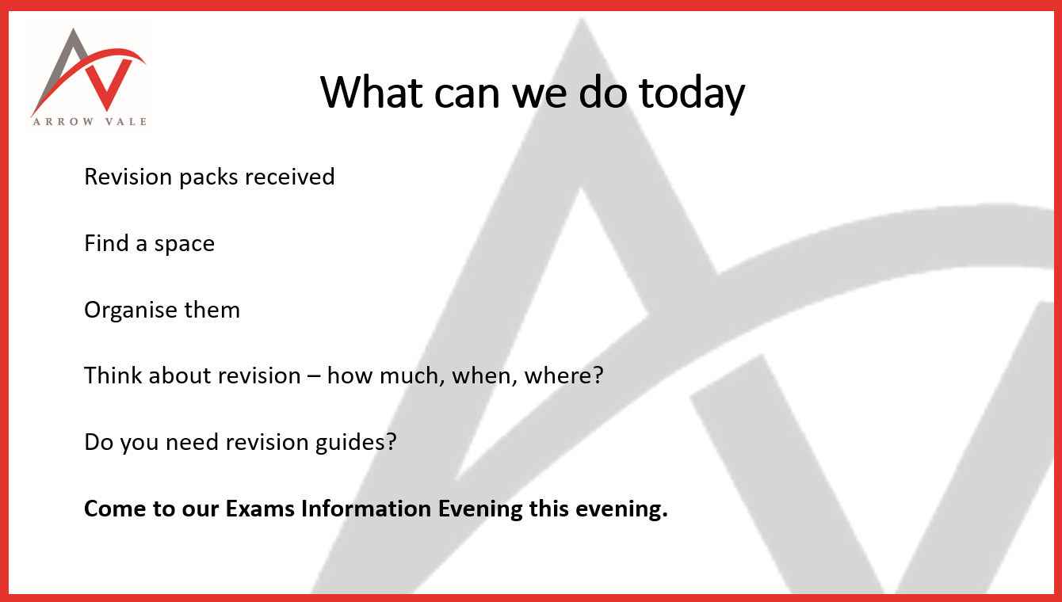
Key Messages from Year 11 Introduction Assembly

