Slide 1
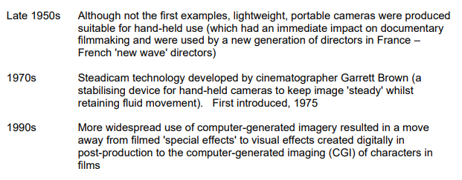
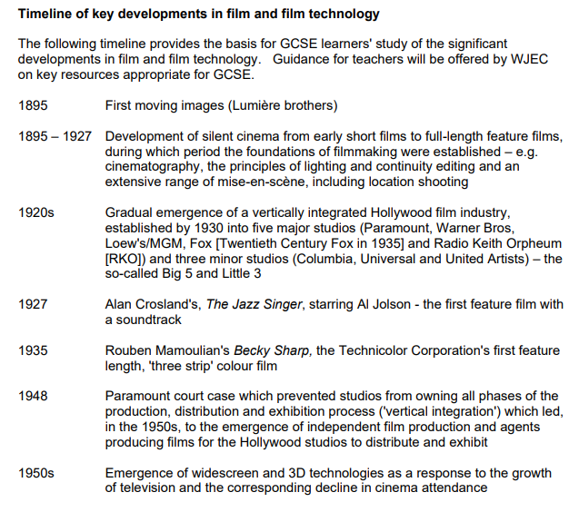
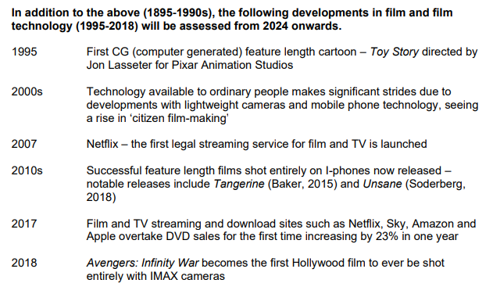

Slide 2
Question and Marks | Answers
What year was the first moving images screened? [1] Who screened the first moving images? [1] | 1895 First moving images (Lumière brothers)
What developments in technology took place between 1895-1927? [3] List three changes that took place between 1895-1927? [3] | 1895 – 1927 Development of silent cinema from early short films to full-length feature films, during which period the foundations of filmmaking were established – e.g. cinematography, the principles of lighting and continuity editing and an extensive range of mise-en-scène, including location shooting
What happened to Hollywood studios in 1920s? [1] List the five vertically integrated studios in of 1920s. [3] List the three horizontally integrated studios in of 1920s. [3] | 1920s Gradual emergence of a vertically integrated Hollywood film industry, established by 1930 into five major studios (Paramount, Warner Bros, Loew's/MGM, Fox [Twentieth Century Fox in 1935] and Radio Keith Orpheum [RKO]) and three minor studios (Columbia, Universal and United Artists) – the so-called Big 5 and Little 3
What feature film was the first with a soundtrack? [1] Who starred in the first ‘talking’ film in 1927? [1] What year was the first talking film released? [1] | 1927 Alan Crosland's, The Jazz Singer, starring Al Jolson - the first feature film with a soundtrack
What year did Rouben Mamoulian direct the first ‘three strip’ colour film? [1] What was the name of this film? [1] | 1935 Rouben Mamoulian's Becky Sharp, the Technicolor Corporation's first feature length, 'three strip' colour film

Slide 3
Question and Marks | Answers
Which vertically integrated studio was involved in a court case to prevent block booking? [1] What year did this studio court case occur? [1] What did this prevent studios from being able to do and ultimately lead to? [3] | 1948 Paramount court case which prevented studios from owning all phases of the production, distribution and exhibition process ('vertical integration') which led, in the 1950s, to the emergence of independent film production and agents producing films for the Hollywood studios to distribute and exhibit
What technological development occurred in the 1950s? [1] What was this development in response to? [1] How did camera technology change in the 1950s? [1] How did camera technology impact documentary film making? [3] | 1950s Emergence of widescreen and 3D technologies as a response to the growth of television and the corresponding decline in cinema attendance Late 1950s. Although not the first examples, lightweight, portable cameras were produced suitable for hand-held use (which had an immediate impact on documentary filmmaking and were used by a new generation of directors in France –French 'new wave' directors)
What did Garrett Brown develop? [1] What year was this technology developed? [1] What year was _______________ equipment first introduced? [1] | 1970s Steadicam technology developed by cinematographer Garrett Brown (a stabilising device for hand-held cameras to keep image 'steady' whilst retaining fluid movement). First introduced, 1975
What major technological developments took place in the 1990s? [1] What is the name of the company who pioneered ____? [1] How did the visual effects change and improve? [3] | 1990s More widespread use of computer-generated imagery, most significantly onwards pioneered by Industrial Light and Magic in the 1970s, resulted in a move away from filmed 'special effects' to visual effects created digitally in post-production to the computer generated imaging of characters in films

Slide 4
Question and Marks | Answers
What was the first computer generated feature length cartoon? [1] Who directed the first CG cartoon? [1] What year was the first computer generated feature length cartoon? [1] | 1995 First CG (computer generated) feature length cartoon – Toy Story directed by Jon Lasseter for Pixar Animation Studios
What year was Netflix launched? [1] What technology was developed during the 2000s? [2] | 2000s Technology available to ordinary people makes significant strides due to developments with lightweight cameras and mobile phone technology, seeing a rise in ‘citizen film-making’ 2007 Netflix – the first legal streaming service for film and TV is launched
What films were shot on I Phones during the 2010s? [2] | 2010s Successful feature length films shot entirely on I-phones now released – notable releases include Tangerine (Baker, 2015) and Unsane (Soderberg, 2018)
In what year did streaming sites overtake DVD Sales? List three streaming platforms. [3] What is significant about the 2018 Avengers film? [2] | 2017 Film and TV streaming and download sites such as Netflix, Sky, Amazon and Apple overtake DVD sales for the first time increasing by 23% in one year 2018 Avengers: Infinity War becomes the first Hollywood film to ever be shot entirely with IMAX cameras

Slide 5
Question and Marks | Answers
What year was the first moving images screened? [1]
Who screened the first moving images? [1]
What developments in technology took place between 1895-1927? [3]
List three changes that took place between 1895-1927? [3]
What happened to Hollywood studios in 1920s? [1]
List the five vertically integrated studios in of 1920s. [3]
List the three horizontally integrated studios in of 1920s. [3]
What feature film was the first with a soundtrack? [1]
Who starred in the first ‘talking’ film in 1927? [1]
What year was the first talking film released? [1]
What year did Rouben Mamoulian direct the first ‘three strip’ colour film? [1]
What was the name of this film? [1]

Slide 6
Question and Marks | Answers
Which vertically integrated studio was involved in a court case to prevent block booking? [1]
What year did this studio court case occur? [1]
What did this prevent studios from being able to do and ultimately lead to? [3]
What technological development occurred in the 1950s? [1]
What was this development in response to? [1]
How did camera technology change in the 1950s? [1]
How did camera technology impact documentary film making? [3]
What did Garrett Brown develop? [1]
What year was this technology developed? [1]
What year was _______________ equipment first introduced? [1]
What major technological developments took place in the 1990s? [1]
What is the name of the company who pioneered ____? [1]
How did the visual effects change and improve? [3]

Slide 7
Question and Marks | Answers
What was the first computer generated feature length cartoon? [1]
Who directed the first CG cartoon? [1]
What year was the first computer generated feature length cartoon? [1]
What year was Netflix launched? [1]
What technology was developed during the 2000s? [2]
What films were shot on I Phones during the 2010s? [2]
In what year did streaming sites overtake DVD Sales? [1]
List three streaming platforms. [3]
What is significant about the 2018 Avengers film? [2]

